Slide 1
SuperH Quad Rotor Helicopter
By Edison
2014-May-25

Slide 2
主頁
SuperGuard 產品
SuperH 產品
SuperH 有關專利與著作權聲明 3-1
The Revolution of the Helicopters 4-1
The Design 5-2
Patented Technologies 7-2
How is Work 9-1
Communication and Control System 21
Auto-Pilot Management 17
Ground Station 24
Safety 10
Automatically Auto Rotation Control 20
Radar System Anti-coulssion
Parachute

Slide 3
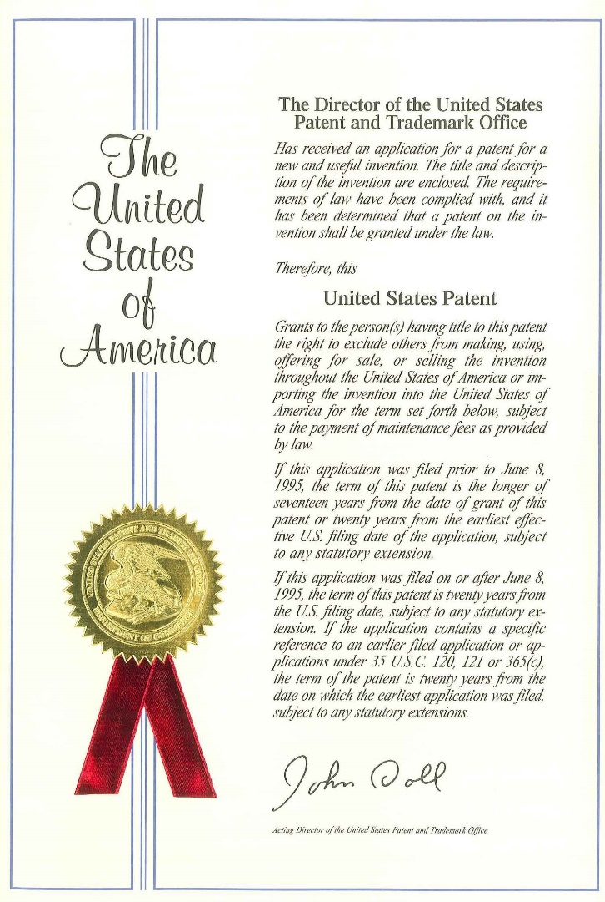
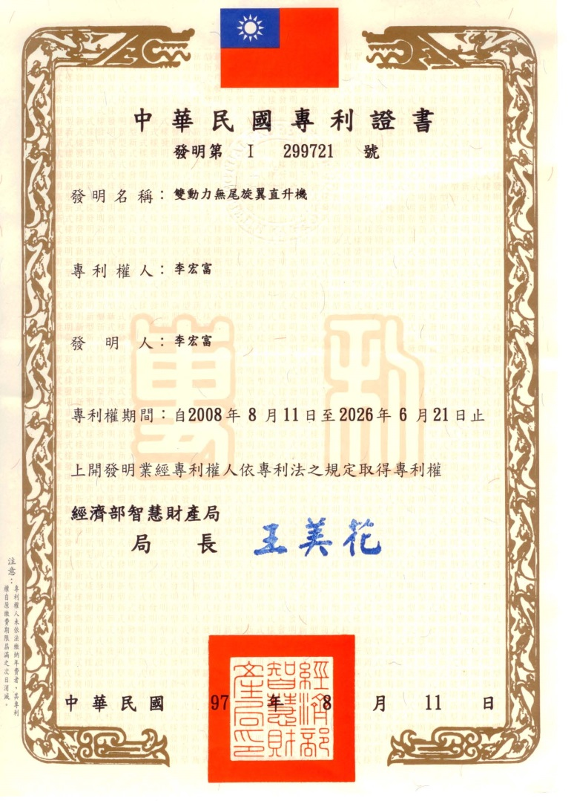
SuperH 有關專利與著作權聲明
註1: 已取得中國大陸專利，領證中

Slide 4
22世紀直升機的重大革命
１ 機身左右之空氣動力完全平衡，可大大簡化飛行之困難度與飛行之風險。
２ 引擎所產生之扭力亦完全平衡，飛行員無須於扭力變化時調整飛機之方向，降低飛行員之負荷。
３ 不須控制左右的尾旋翼，可節省～２０％之引擎動力，提高燃油效率
４ 控制系統較為簡單，無須與傳統直升機主旋翼一樣的控制方式。
５ 有足夠的空間安裝彈射降落傘，當緊急時可彈射降落傘，保護人員與飛機之安全。
６ 四個主旋翼使用了擋風罩（ＤＵＣＴ ＦＡＮ），除了可以增加旋翼效率外，更可降低四個主旋翼相互之間的影響，可大大降低旋翼的噪音。
７ 各主旋翼均使用了擋風罩（ＤＵＣＴ ＦＡＮ），它可減少飛行空速對翼間所產生的影響，降低翼尖空速（Ｔｉｐ Ｓｐｅｅｄ），進而提高本直昇機之空速。

Slide 5
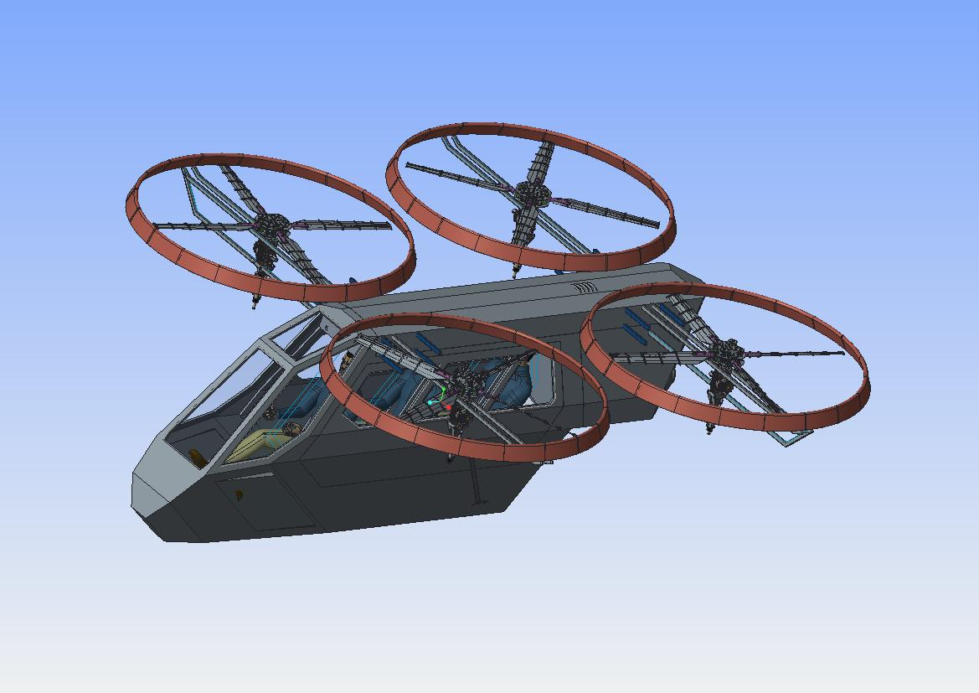
SuperH Design
四旋翼三人座直升機
1, 160hp Gas Turbine Engine
2, 四旋翼可變螺距飛控系統
3, 雙10軸電子穩性系統
4, 雙線傳飛控系統
5, 自動緊急自旋降落系統
6, 搭載緊急降落傘
7, 船型結構, 可漂浮於水面

Slide 6
SuperH Design---Ｈ型結構之直升機設計
Ｈ型結構之直升機，主要是利用二對轉向相反之旋翼組，分別設置在機體的前段區域與尾端區域的兩側，藉以，透過兩對轉向相反之旋翼組，使其左右兩端之旋翼組所產生之扭力達到相互抵銷的效果，進而保持直升機飛行時之平衡控制飛行姿態與轉向，機械結構簡單並可以確保直升機飛行之安全性。

Slide 7
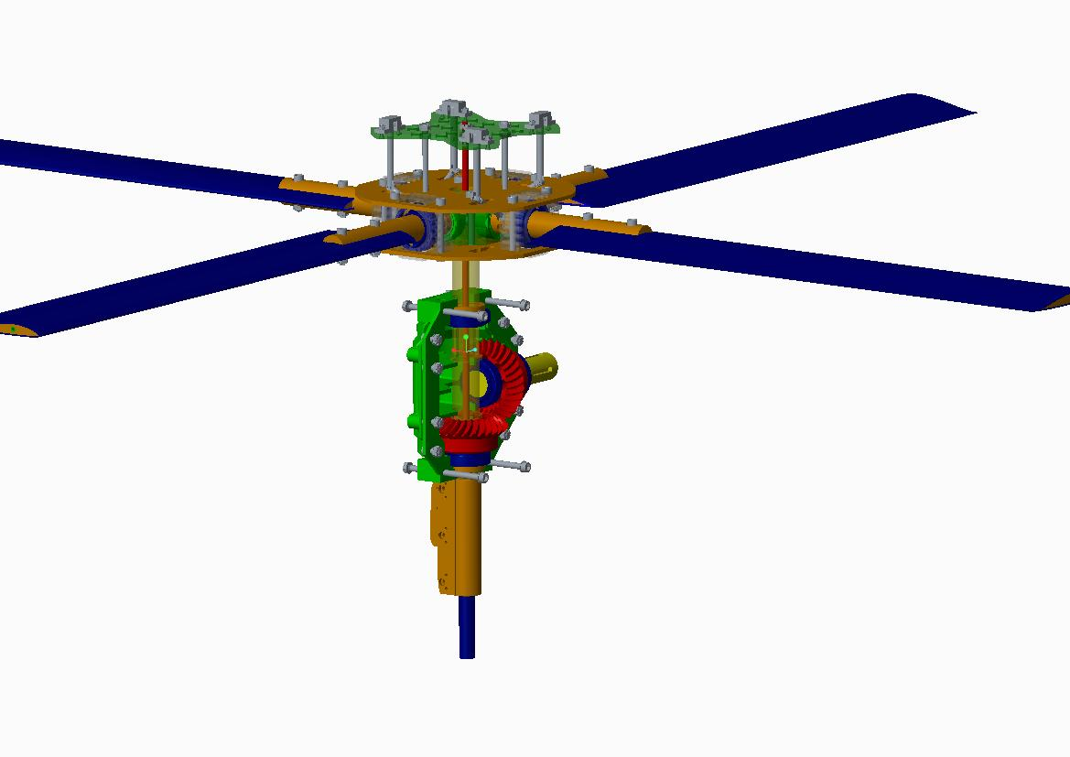
Patented Technologies 專利技術
Angle Distributor
Gear Box
Driving Shaft
Push-Pull Bar
Linear Server Motor

Slide 8
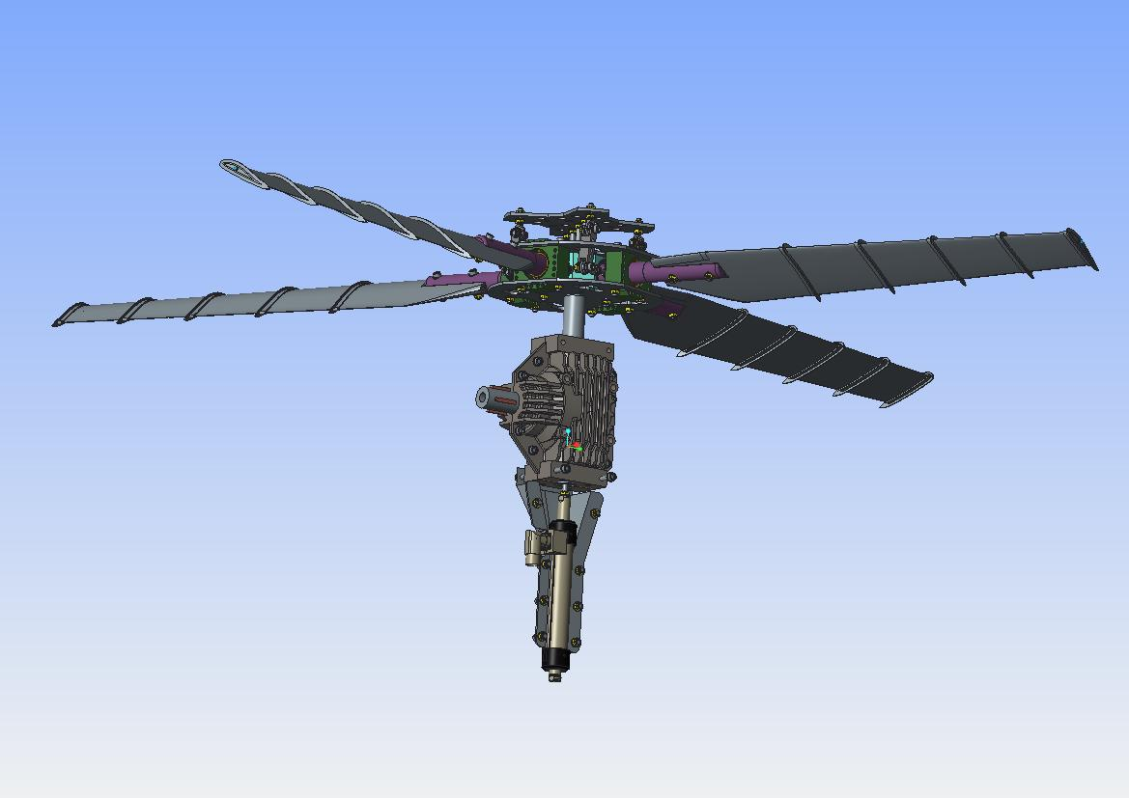
Zero-Friction Linear Motor Fly-By-Wire System
Dual loop Fly By Wire System with ZERO FRACTION, ZERO CONTACT Linear Sever Motor
***Available on SuperH only

Slide 9
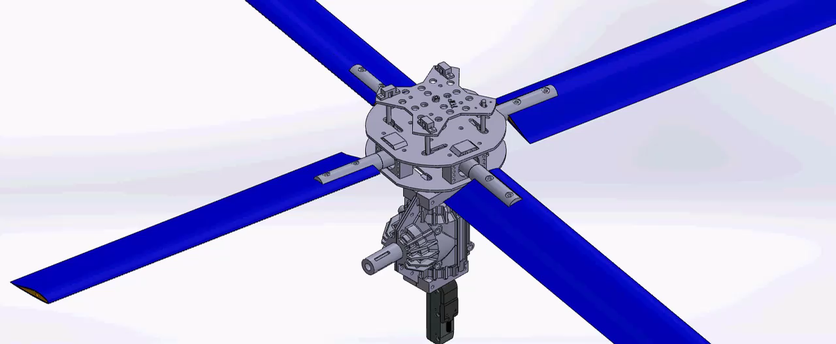
How is Work

Slide 10
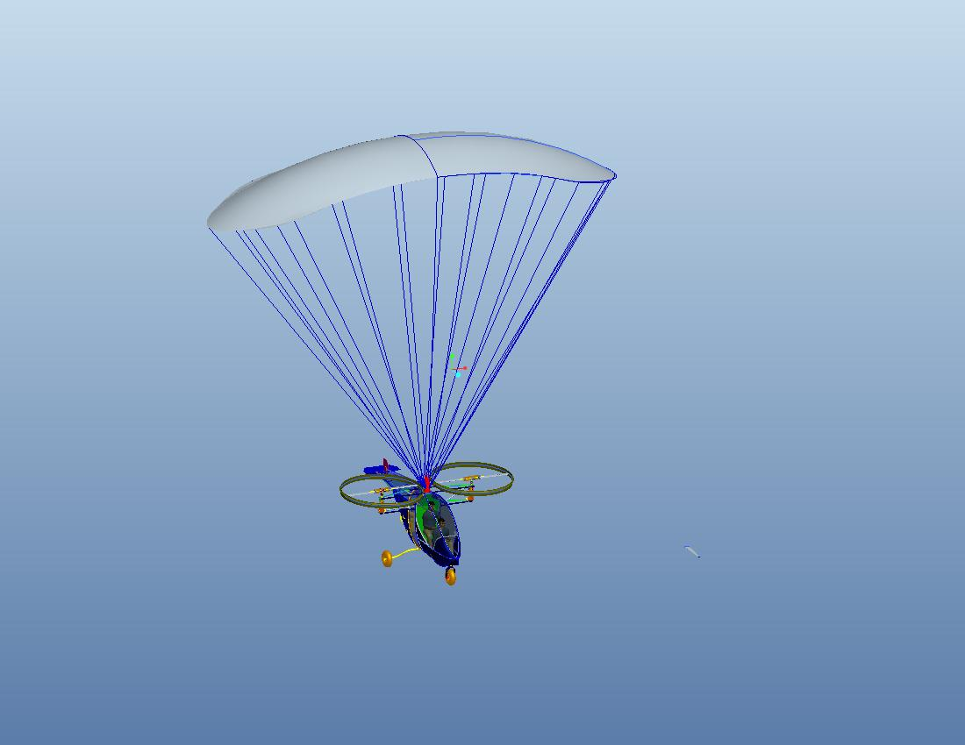
Safety---Parachute

Slide 11
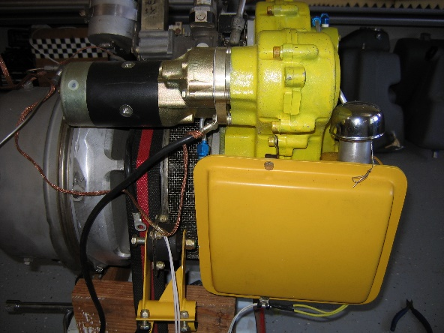
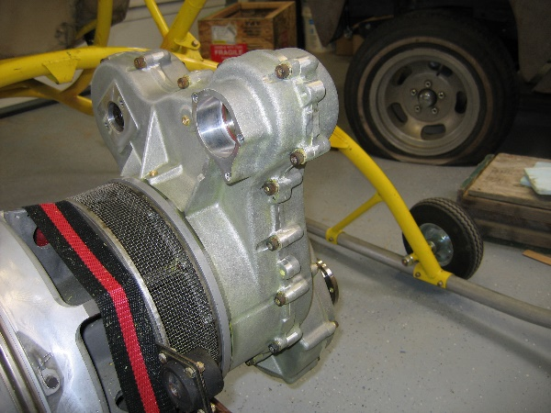
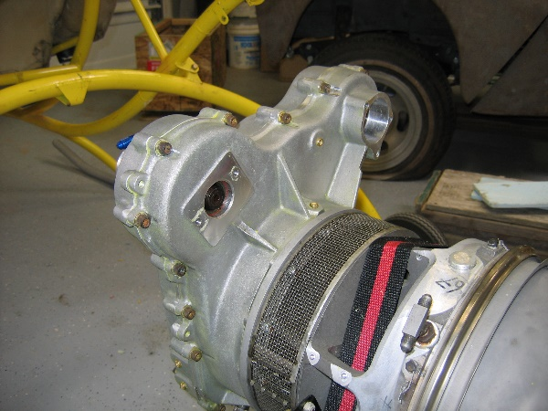
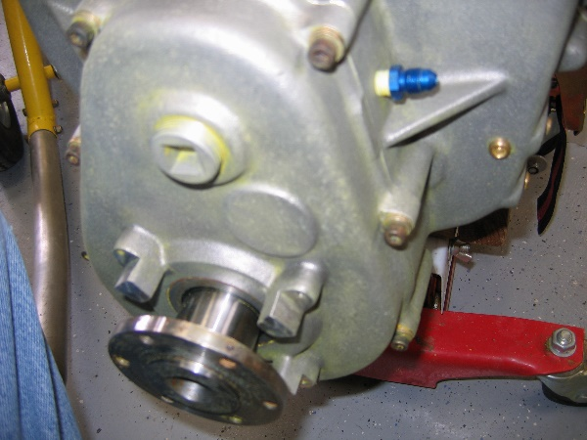
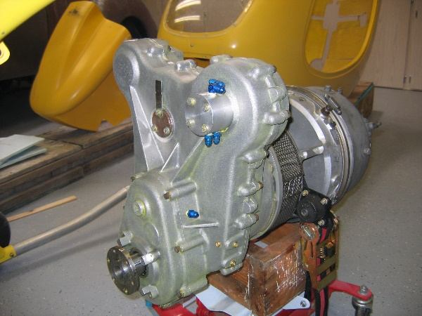
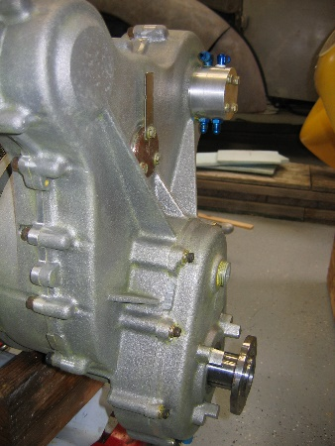
T62 Gas Turbine Engine

Slide 12
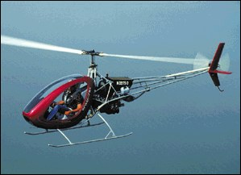
現有產品 HELICYCLE

Slide 13
Specifications
Modified Solar T62 turbine | 160 derated to 90 hp
Single Seat | 220 lbs, 100kgs max
Gross Weight | 850 lbs, 386kgs
Empty Weight | 500 lbs, 227kgs
Fuel Capacity (Note: Optional +5 only for 180lb & Less pilot weight) | 21 (16 + 5 reserve) US gal
Range with reserve | 160 miles, 256km
Rate of Climb | 900 fpm, 270mpm
Hover IGE | 9,500 ft, 2800m
Service ceiling | 11,000 ft, 3300m
Normal cruise with doors | 95 mph, 150km/hr
Max airspeed at sea level @ standard conditions | 110 mph, 176km/hr

Slide 14
性能與特色
PERFORMANCE:( Speed & Altitude )
The HELICYCLE in it's normal configuration is designed to cruise along side the industry standard R-22. Landings and take offs at above 9000 ft. are possible because of a 7.5/1 power to weight ratio. The same as the Hughes 500.
FLIGHT STABILITY: ( Wind & Gust )
Aircraft stability is always challenged by adverse weather conditions. It is normally assumed that lighter aircraft will be further affected. The HELICYCLE at one half the weight of the R-22 is capable of being operated in the same weather conditions as the R-22, with no appreciable increase in pilot work load over that of the R-22.
HANDLING QUALITIES
The HELICYCLE has numerous design features which improve it's handling qualities. These include:
A fully harmonized rotor.
A modulated collective system.
Very low 2-per-rev vibration level due to elastomeric thrust bearings.
Generous flapping angle for low "G" and slope landing conditions.
Control friction devices.
Electronic throttle control.

Slide 15
COST OF OPERATION : (In cost per air mile)
COST OF OPERATION : (In cost per air mile)
Direct Operation Cost: Fuel-Jet8 US$ 0.11
Indirect Operating Costs:
Routine maintenance at 100 hour intervals | $0.03
Engine maintenance at 250 hour intervals | $0.03
Engine replacement | $0.11
Airframe retirement time parts reserve fund | $0.09
Total | $0.37 per mile
1 air mile = 1 1/2 road miles on average. It's easy to see that the per mile cost of the HELICYCLE is less than that of a pick-up truck. This cost estimate assumes a new engine every 750 hours and a 1500 hour complete airframe overhaul. This schedule keeps the ship in constant new condition. A 45 minute commute is equivalent on average to a 15-17 minute flight considering no traffic and no stop lights for the helicopter. This is a time savings of over two days per month!
LOW ROUTINE MAINTENANCE: (100 hour intervals)
It is well known that the R-22 needs very little mechanical attention at 100 hour intervals. This is largely operation with the HELICYCLE and 30+ years of helicopter design experience, we feel confident that the HELICYCLE components will stand up equally as well. There are some differences. The R-22 utilizes mostly sealed bearings, so little greasing is necessary. To aid in controlling costs, the HELICYCLE compromises in this area with a 50/50 approach. There are 12 grease zerks and 2 sliders that do need a minute or two of attention now then, the rest of the bearings are sealed.

Slide 17
Auto-Pilot Management---Triple Redundant
Three complete autopilots, advanced voting logic, carrier phase GPS, for helicopters and Multi-Rotors.
Triple redundancy (3X) gives autopilot technology the reliability necessary to safely carry out sensitive flight missions and transport valuable payloads. A triple redundant arrangement is comprised of three similar software and hardware systems. If any one of the three systems fails, the remaining two take over, offering a double redundancy arrangement. If one of the other two systems should fail, the third takes over. An additional mechanism is also included to oversee these three systems. Triple redundant systems are highly tolerant of autopilot hardware failures.
Triple redundant autopilots are not new. Military aircrafts such as the RAF’s Trident fleet, used a triple redundant autoland system in the early 1960’s. Ten years later, the Aérospatiale-BAC Concorde took advantage of 3X technology in its flight control system. Presently, triple redundancy is used in several manned military and commercial aircrafts.
Although triple redundant technology is established within the aviation industry, triple redundant autopilots are a relatively new addition to unmanned aerial vehicles (UAVs). SuperH, the leading UAV autopilot manufacturer, is setting the benchmark for triple redundant UAV autopilots.

Slide 18
Key Features
Fly both Multi-Rotors and helicopter UAVs. Multiple communication links for onboard devices such as cameras and aircraft transponders. Redundant datalinks to ground control station. Configuration, state and waypoint synchronization among all three autopilots. 11 serial ports including RS232 and RS485. 16 independently-generated servo signals. 8 high current drivers controlled independently by each autopilot. Pass or fail voting logic reliably selects the appropriate autopilot. Android ground control station software with built-in software in the loop simulator. Feedback loop synchronization ensures smooth transition when switching autopilots. Zero Friction Linear Motor with dual loop Fly-By-Wire Control

Slide 19
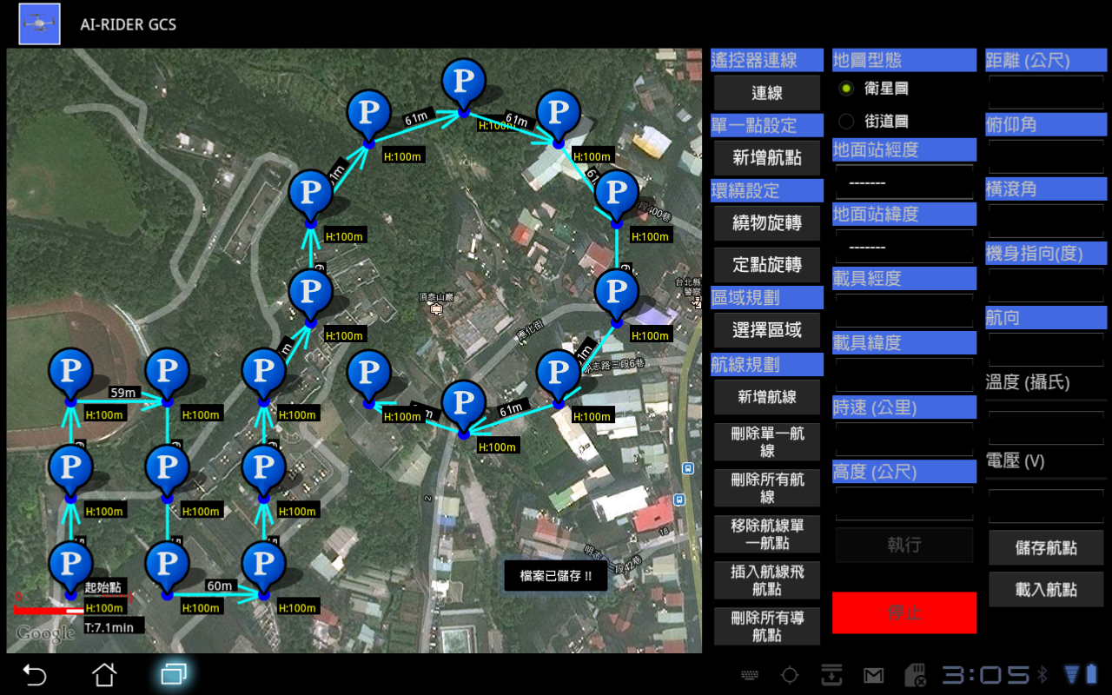
Pre-set Check-Point from the SKY

Slide 20
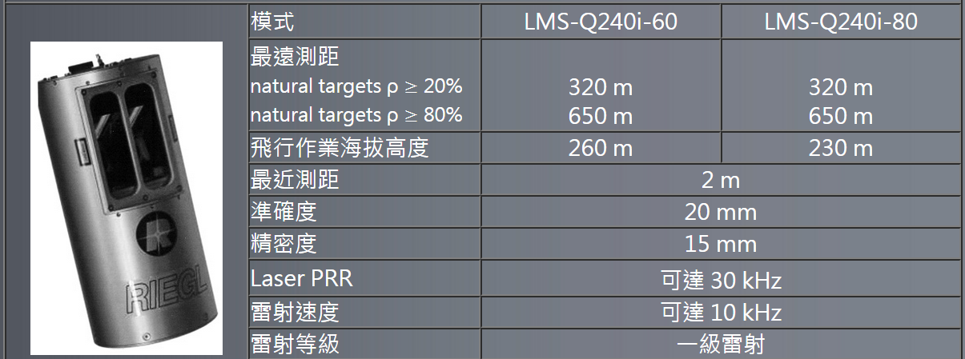
Radar System
Can be config two Rader System, Horizon Rader and Vertical Rader.

Slide 21
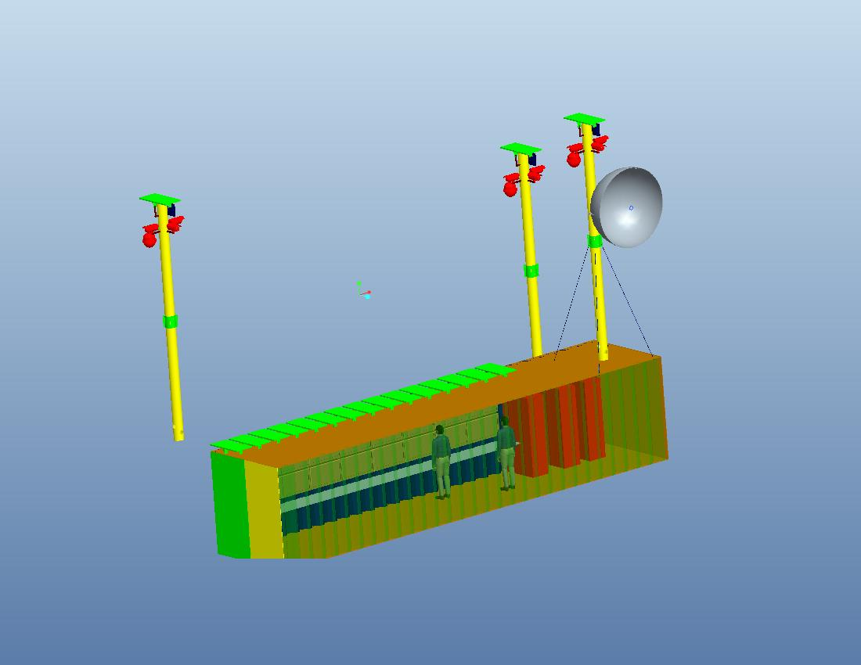
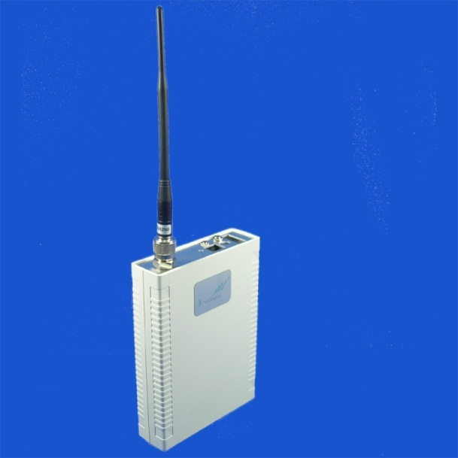
Communication and Control System
Real-Time Video to Control Center. Up to 700Meters range.

Slide 22
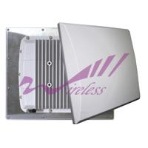
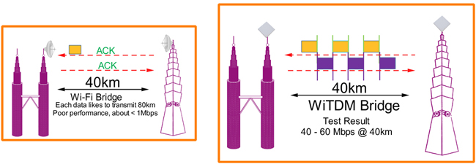
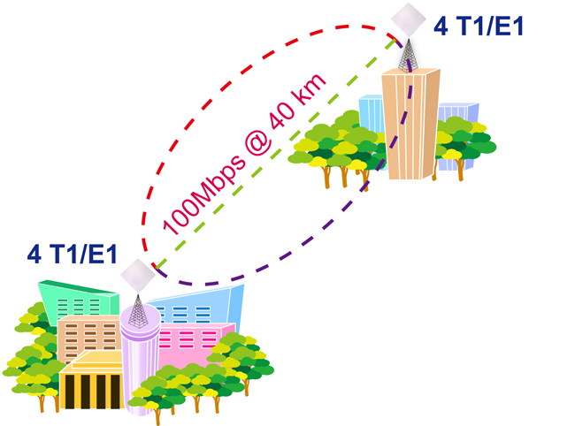
Wireless

Slide 23
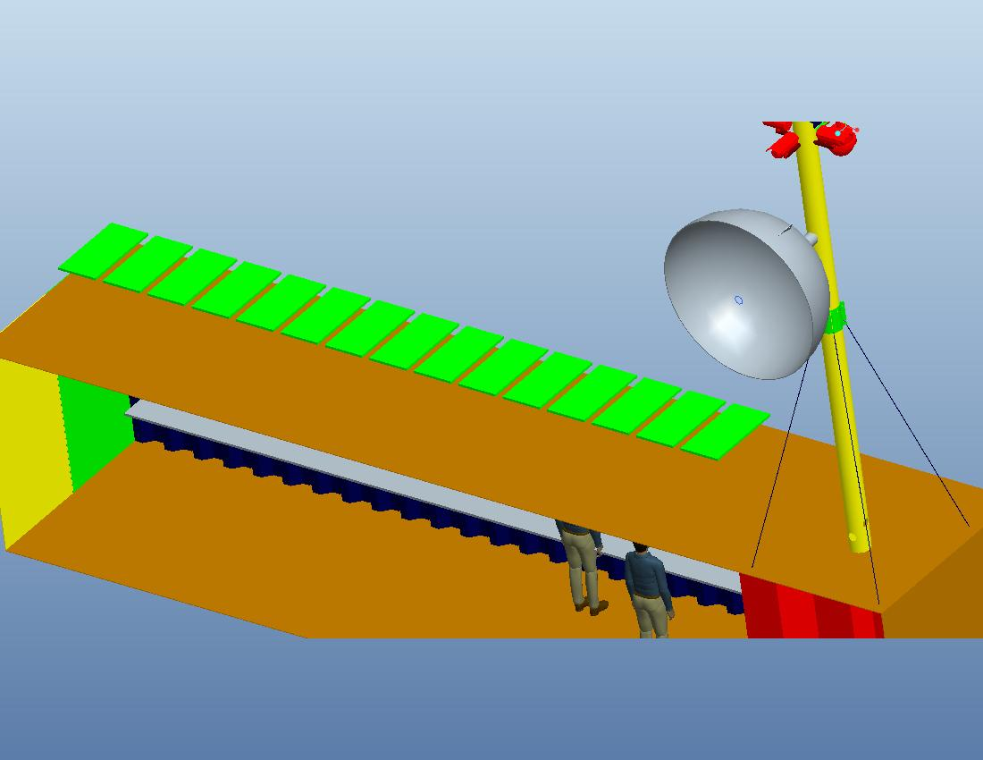
500km Microwave Internet Access
A 2 meters dish antenna to be connect to the city which with board-band internet access. Up to 500km with over 80mbps connection to ensure that the non-stop security, and monitoring. The top management can be easily to access real-time video, reports and communication over Smart phone or any internet.

Slide 24
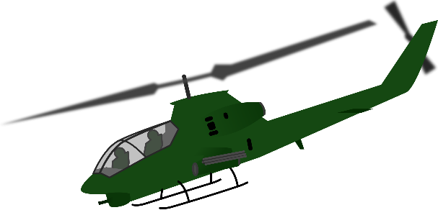
Ground Station
Up to 500km
Up to 5km

Slide 25
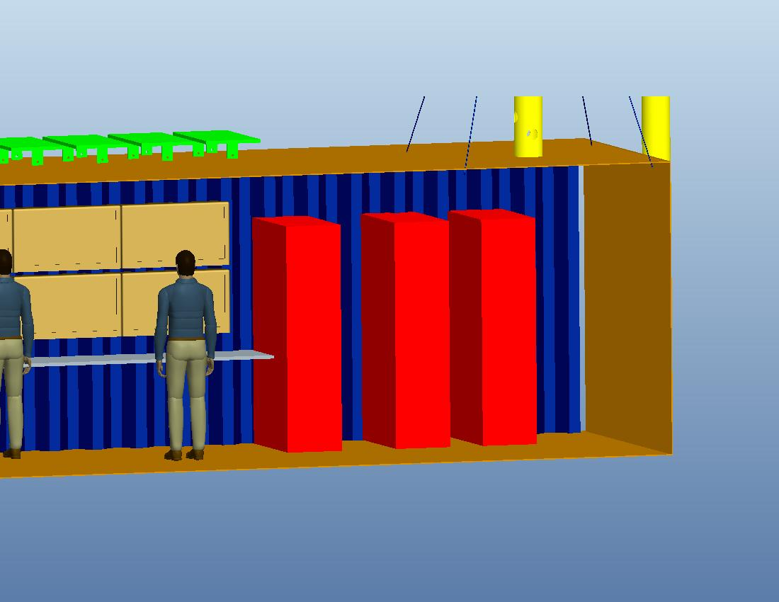
Blade Server, UPS and Battery Bank
3000W
Solar Power
LED TV wall
Blade Server, UPS and Battery Bank

Slide 26

The IVA Control Center

Slide 27
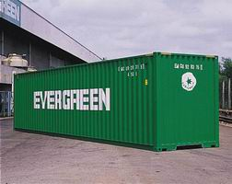
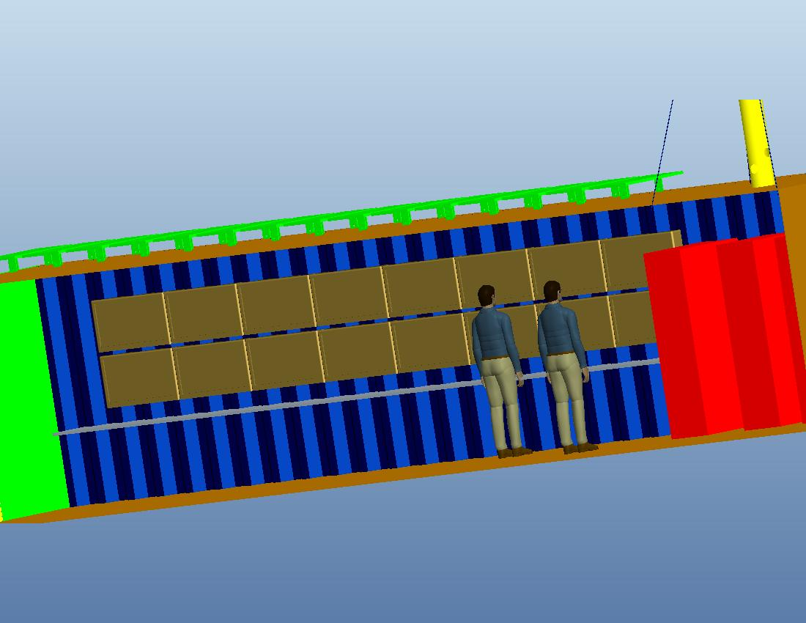
Control Center Over-View
Control Center are build into a Customized 40ft Container
ground

Slide 29
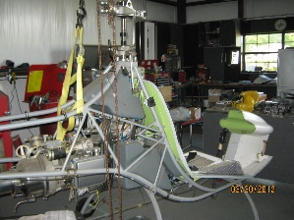
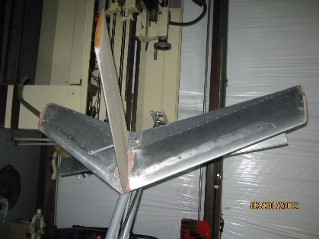
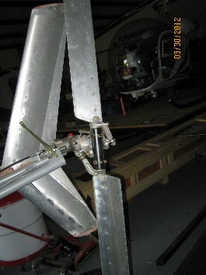
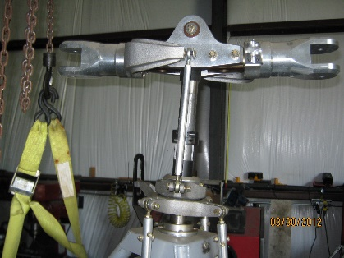
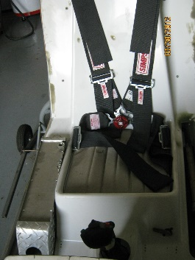
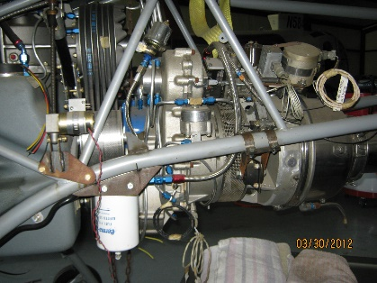
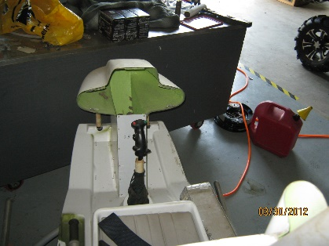
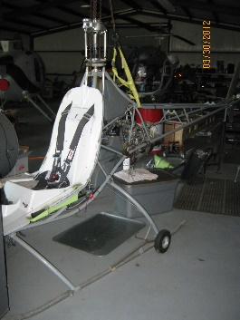
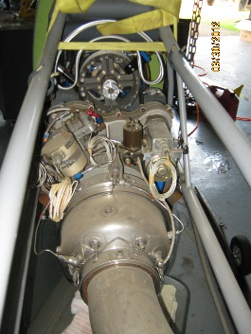
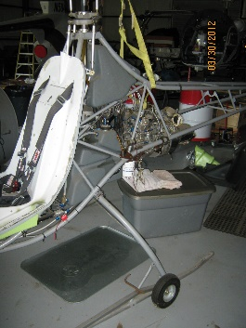
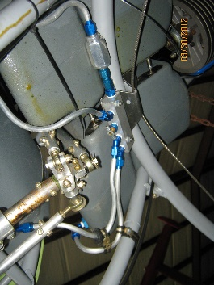
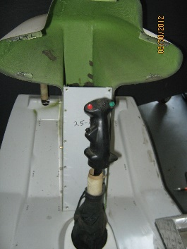
現有產品 HELICYCLE

Slide 30
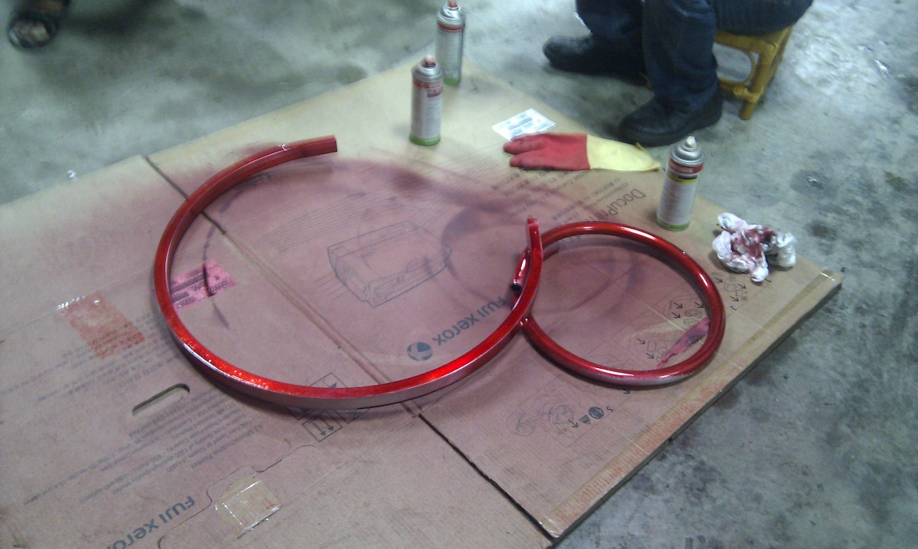
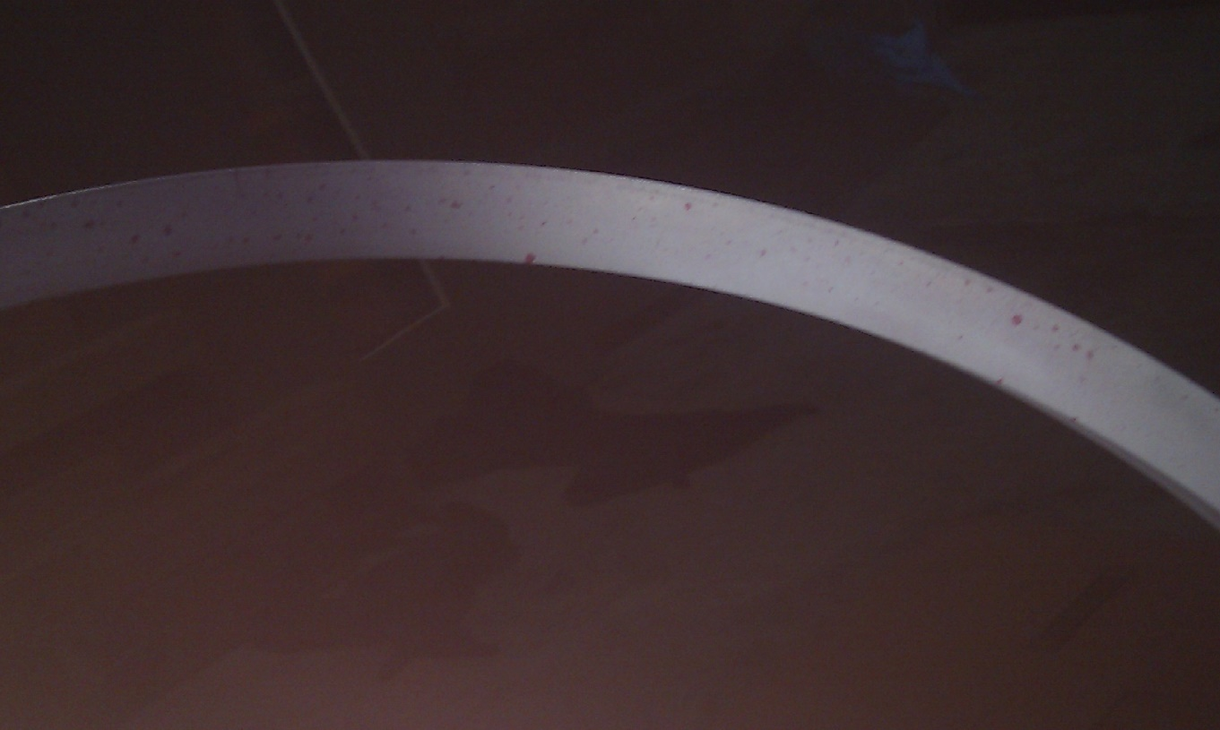
鋁合金斷裂測試

Slide 31
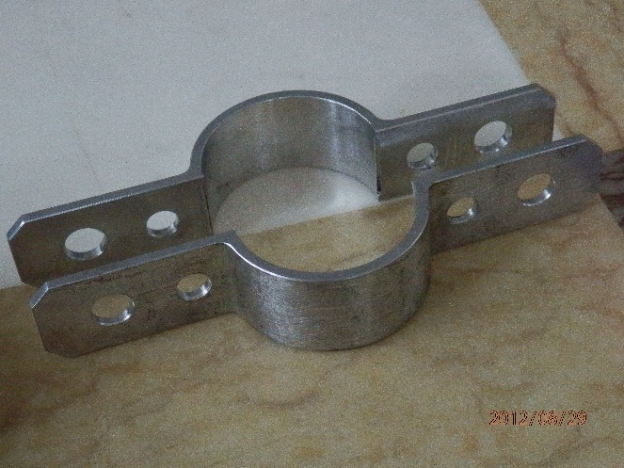
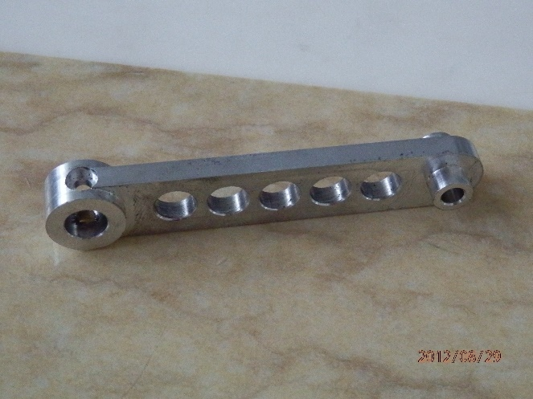
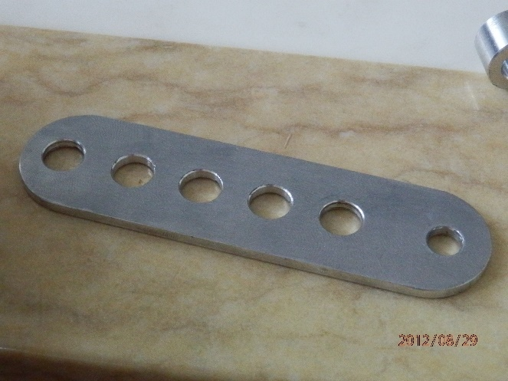
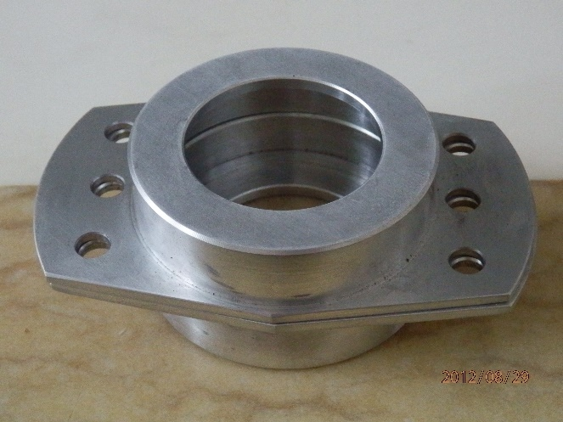
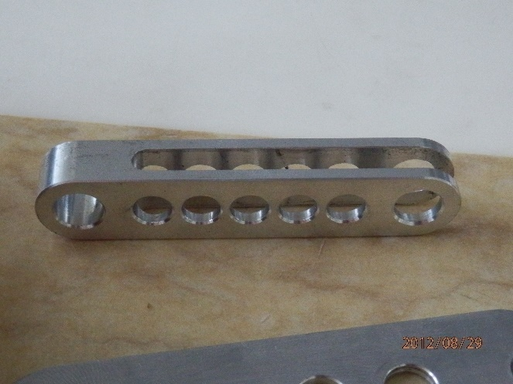
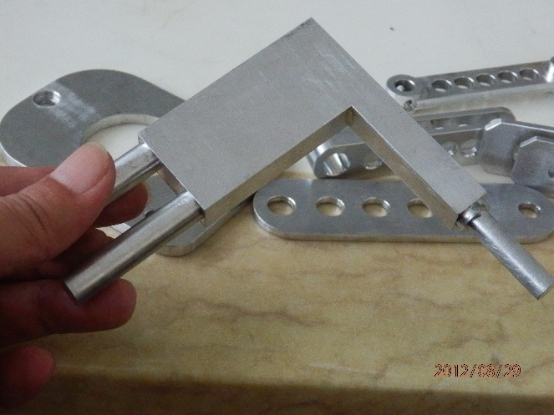
零件製造過程

Slide 32
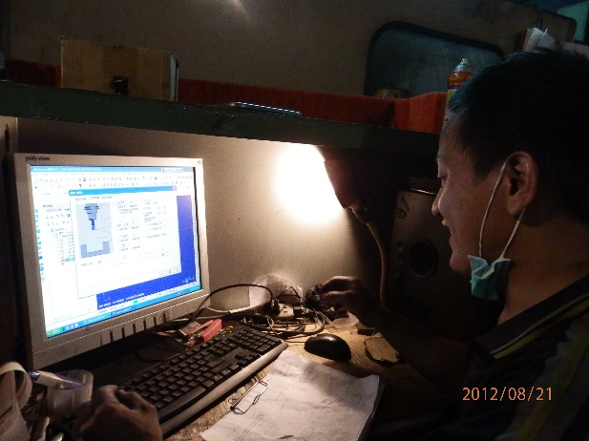
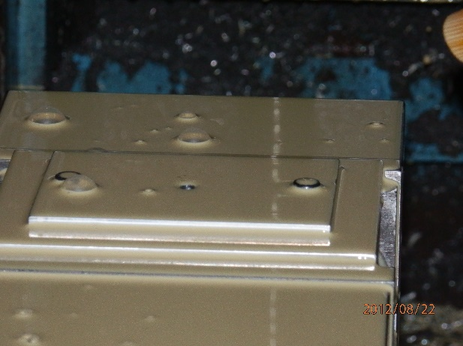
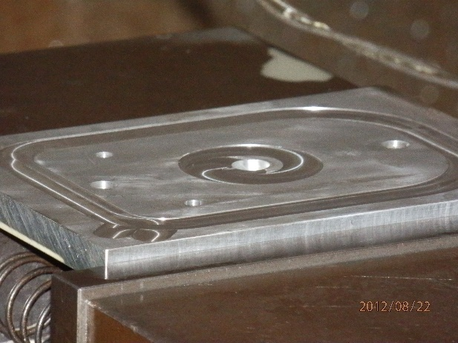
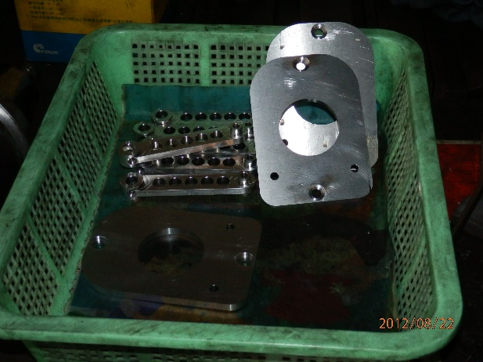




零件製造過程

Slide 33
航太級3D列印

Slide 34

核心材料

